Slide 1
24V PSU
DC-DC CV-CC Module
Fuse/
crowbar
LED Light source
L298N Bridge driver
Estop/interlocks
Motor drive
Linear actuator
DC-DC CV-CC Module
Fuse/
crowbar
LED Light source
Tacho signal
Actuator power
Tacho power
DC-DC CV Module
Fuse/
crowbar
Spare analogue pro-micro input
Camera
Linear scale
(currently via Pi Pico)
Motor PWM
Interlock signal
Motor direction
Motor current
CSI Camera bus
Hardware jog control
Arduino pro-micro (common 5v variant)
Pi cooling fan
USB
LED current control
I²C 5v
BSS138 based level shifter
I²C 3.3v
Raspberry Pi 4
(GPIO brought out to pass-through connector: all pins used are via cuttable jumpers)
GPIO 5v
GPIO 3.3v
DC-DC CV Module
5v digital power
5v power to Pi
Fuse/
crowbar
External load cell amplifier enclosure
Digital power
3.3v power from
Pi (on-board regulator)
5V Linear regulator
Spare data bussses
SPI 3.3v
5V analogue power
Signal key
24v Input power
5v Digital power
3.3v Digital power
5v Analogue power
General signal
Data bus
Drive power path
Load cell input A
Footprint for NAU7802
User interface and instrument control (monitor/
keyboard/
mouse)
Load cell input B
Footprint for HX711

Slide 2
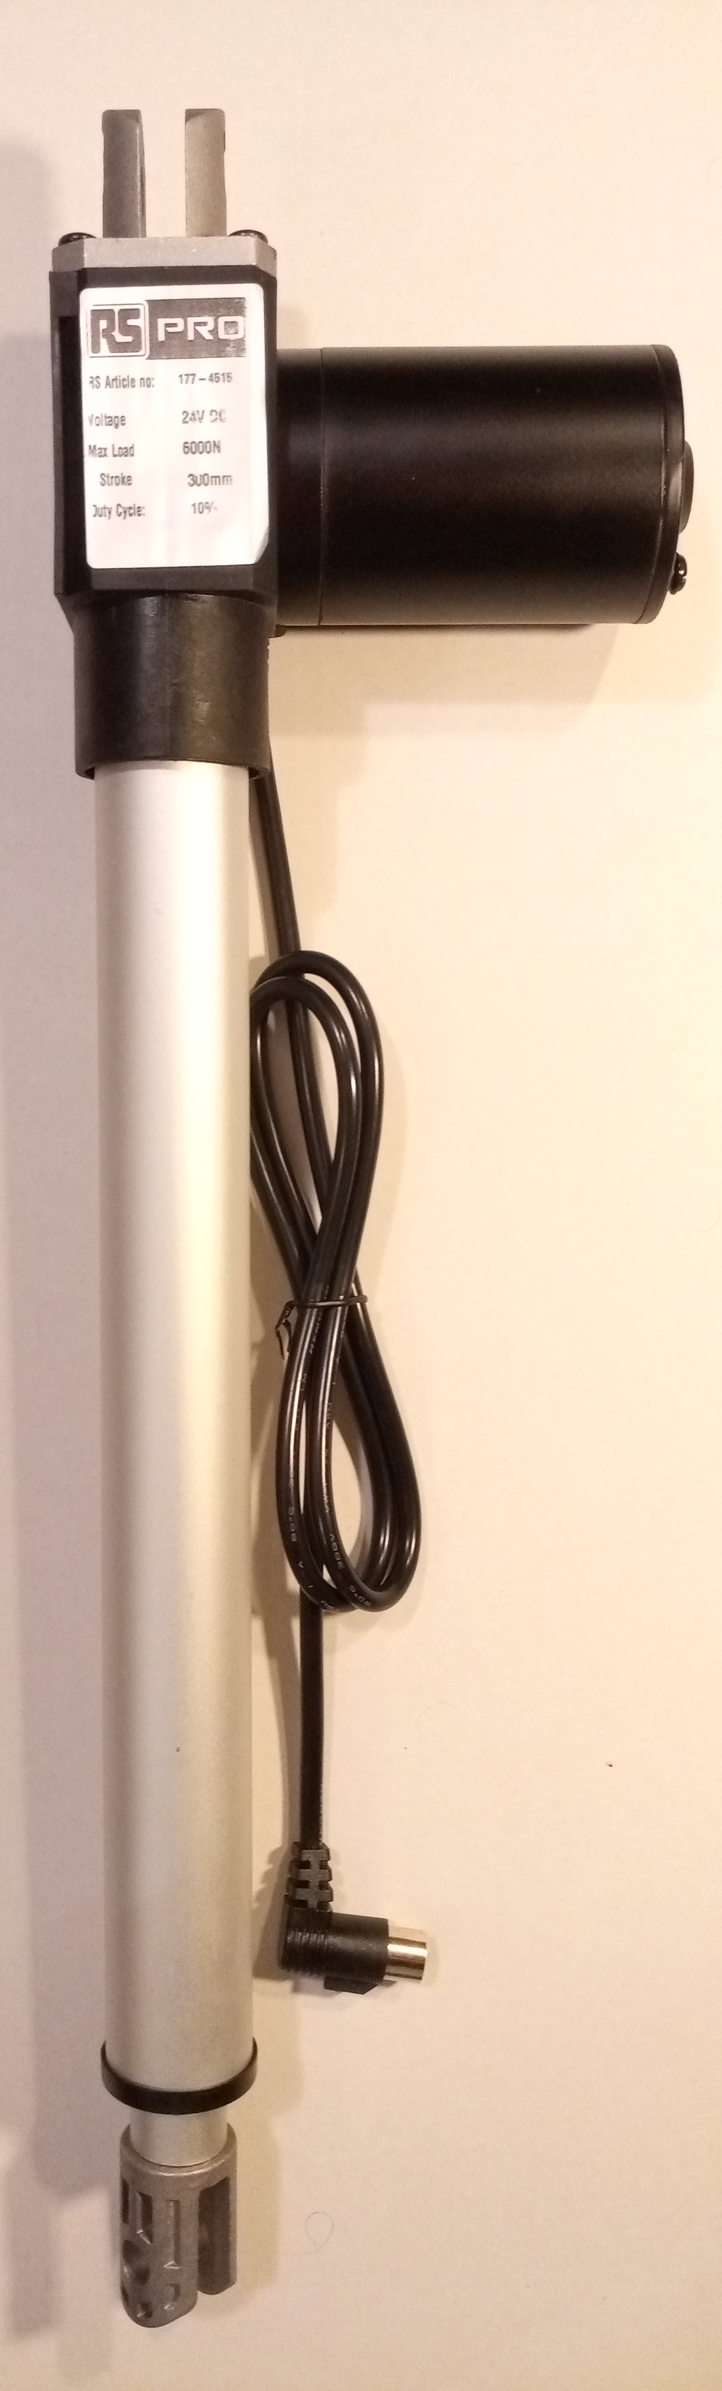
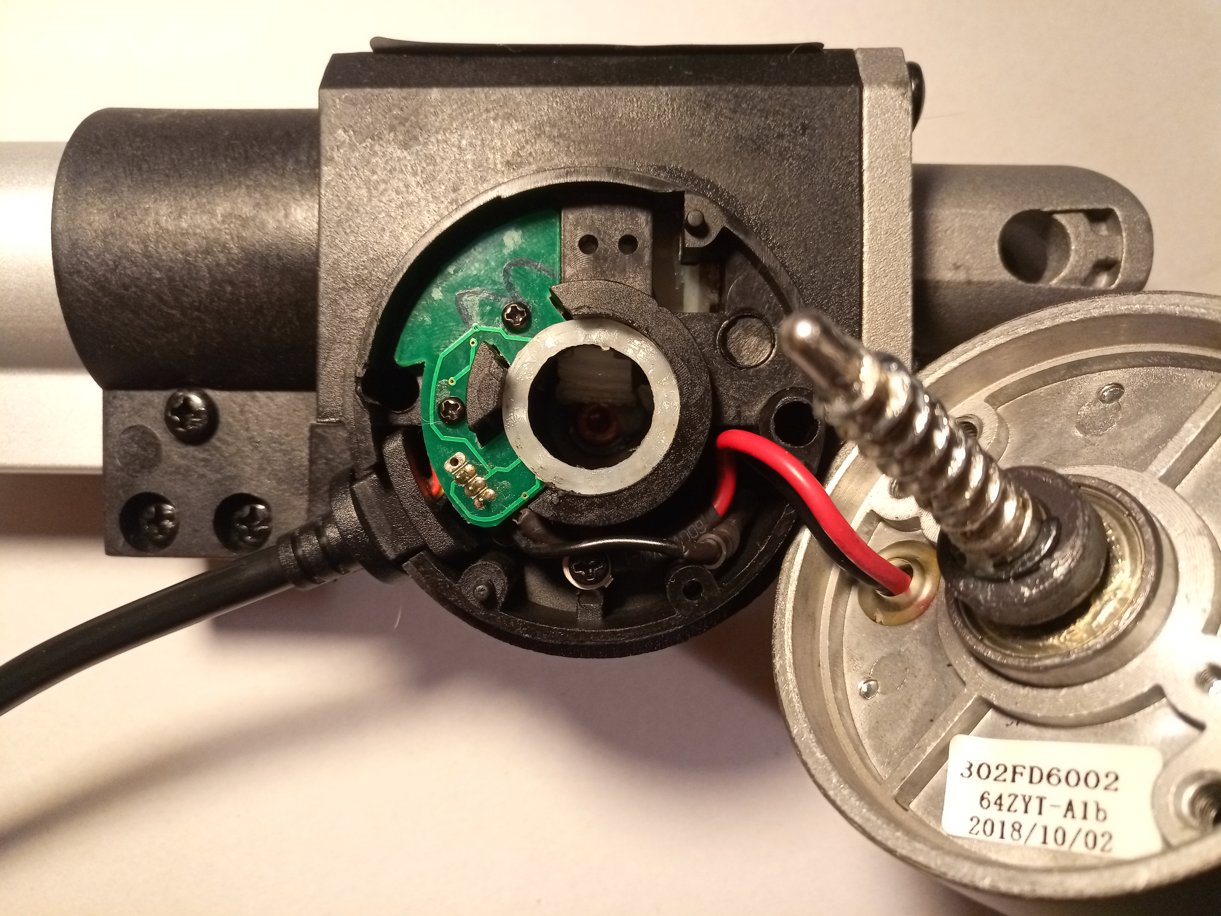
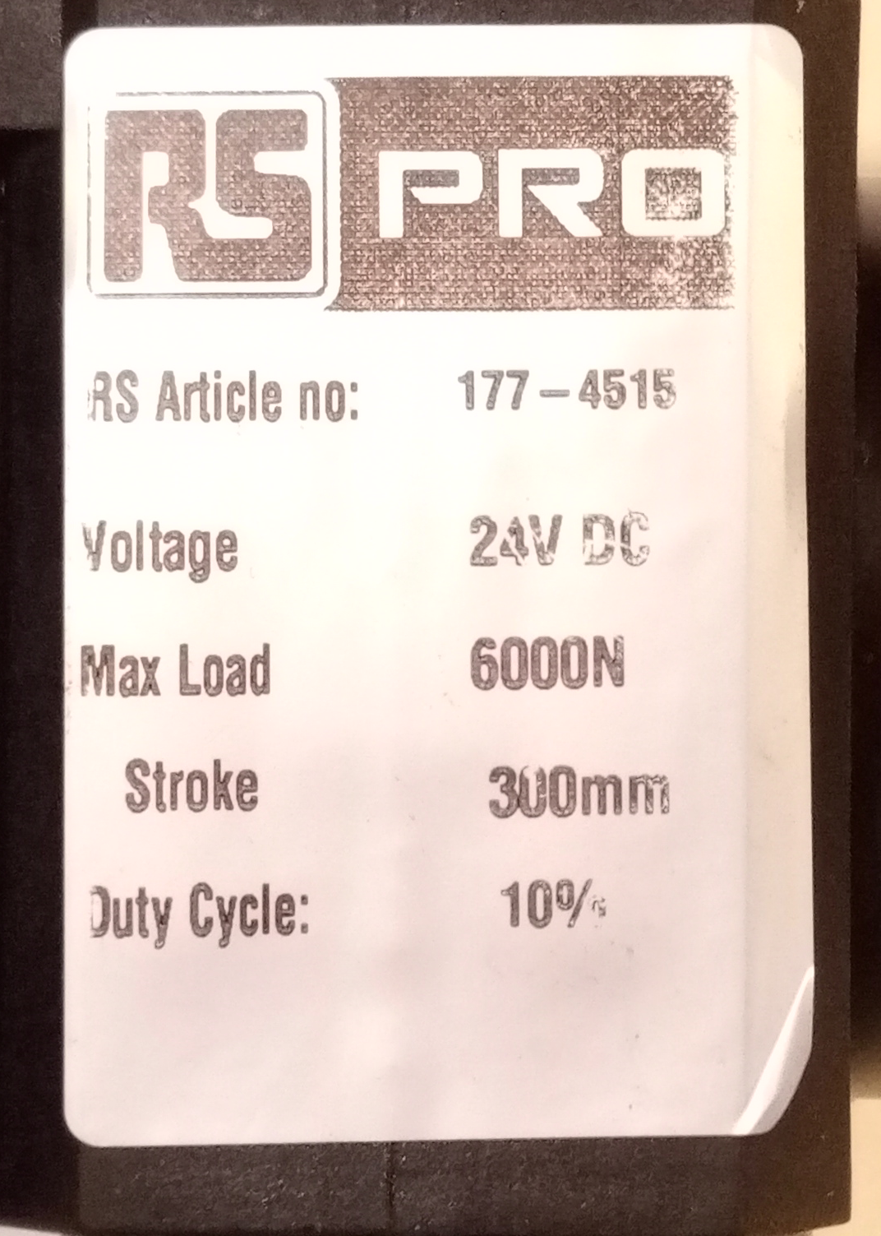
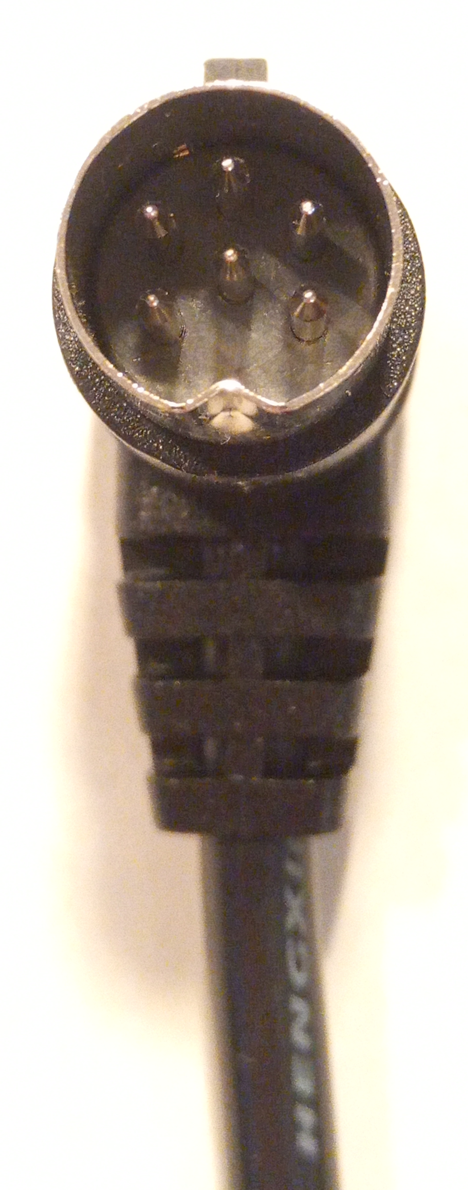
Sensor 0v
Motor
Sensor +5v power
Motor (via limit switches)
Hall effect sensor
Rotating magnet
Drive motor
Sensor output
Drive worm gear
Centre pin
not connected

